Slide 1
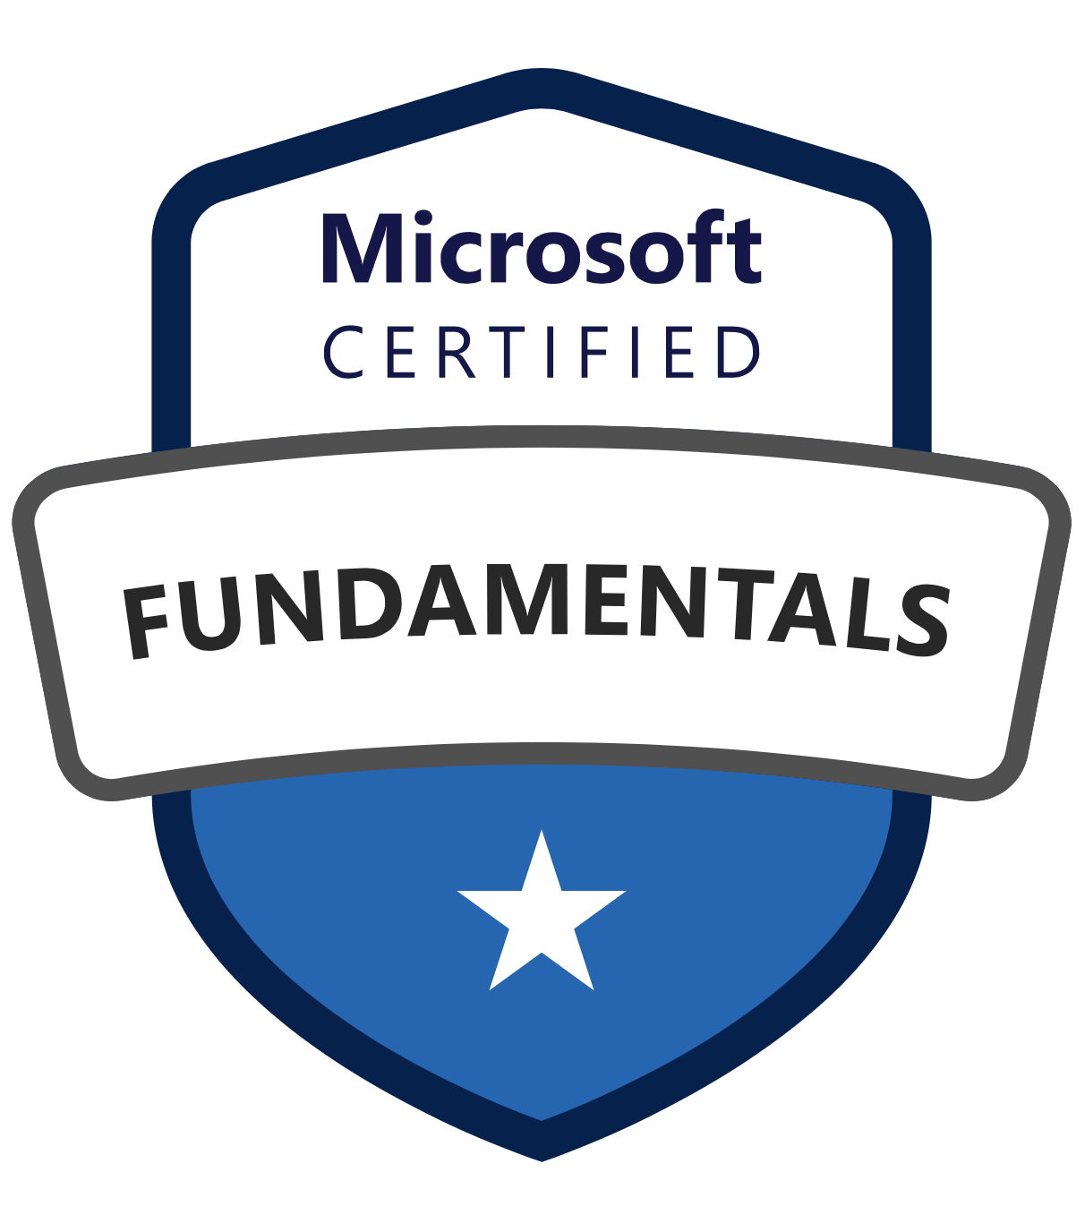
Exam: PL-900: Microsoft Power Platform Fundamentals
Certification: Microsoft Certified: Power Platform Fundamentals
Learning Path: Microsoft Power Platform Fundamentals
Last Updated: April 2020

Slide 2
Skills Measured
1. Understand the business value of Power Platform Describe the value of Power Platform applications analyze data by using Power BI act with Power Apps build solutions that use Common Data Service (CDS) automate with Power Automate interoperate with external systems and data Describe the value of connecting business solutions Dynamics 365, Microsoft 365, Microsoft Azure, third-party services and apps Understand Power Platform administration and security understand how Power Platform implements security understand Power Platform as a service describe how to manage apps and users describe admin centers understand how the platform supports compliance | 3. Demonstrate the business value of Power BI Understand common components in Power BI identify and describe uses for visualization controls describe types of filters describe Tabs custom visuals compare and contrast dashboards and workspaces compare and contrast Power BI Desktop and Power BI Service Connect to and consume data combine multiple data sources clean and transform data describe and implement aggregate functions identify available types of data sources describe and consume shared datasets and template apps Build a basic dashboard using Power BI design a Power BI dashboard design data layout and mapping publish and share reports and dashboards | 5. Demonstrate the business value of Power Automate Understand the common components of Power Automate flow types templates connectors triggers conditions expressions approvals Build a basic flow create a business process flow implement a Power Automate template modify a flow run a flow export a flow to Logic Apps
2. Understand the Core Components of Power Platform Understand Common Data Services user experience vs unique job role using Power Apps identify entities, fields, and relationships describe environments describe use cases and limitations of Business process flows describe use cases and limitations of business rules describe the Common Data Model (CDM) identify common standard entities Understand Connectors describe uses for and types of triggers describe actions describe connectors identify use cases for custom connectors Understand AI Builder identify the business value of AI Builder describe models consumption by the Power Platform | 4. Demonstrate the business value of Power Apps Understand common components in Power Apps describe canvas apps describe model-driven apps identify and describe controls understand uses for templates understand use cases for formulas Build a basic canvas app connect to data use controls to design the user experience describe the customer journey publish and share an app Understand Power Apps portals describe use case for and the business value of portals describe how to extend CDS data, use controls, and embed Power BI objects
20-25%
15-20%
15-20%
20-25%
20-25%

Slide 3
20-25%
1. Understand the business value of Power Platform

Slide 4
1a. Describe the value of Power Platform applications
Power Platform
Power Platform is comprised of four key products: Power Apps, Power Automate, and Power BI and Power Virtual Agents.
Power Platform
Power Apps
Power Apps provides a rapid low code development environment for building custom apps for business needs. Power Apps enables the creation of web and mobile applications that run on all devices.
Power Apps
Power BI
Power BI (Business Intelligence) is a business analytics service that delivers insights for analyzing data. It can share those insights through data visualizations which make up reports and dashboards to enable fast, informed decisions.
Power BI
Power Automate
Power Automate lets users create automated workflows between applications and services. It helps automate repetitive business processes such as communication, data collections, and decision approvals.
Power Automate
Power Virtual Agents
Easily build chatbots to engage conversationally with your customers and employees—no coding required.
Power Virtual Agents
Data
Tabular data - A tabular data source is one that returns data in a structured table format. Power Apps can directly read and display these tables through galleries, forms, and other controls. Function-based data - A function-based data source is one that uses functions to interact with the data source.
Data
Common Data Service (CDS)
Common Data Service is a scalable data service and app platform which lets users securely store and manage data from multiple sources and integrate that data in business applications using a common data model to ensure ease and consistency to users.
Common Data Service (CDS)

Slide 5
1b. Describe the value of connecting business solutions
Value Proposition
Value Proposition
Connect to hundreds of data sources using a library of connectors and Common Data Service—bringing your data together for a single source of truth while you uncover insights as well as customize and extend Office 365, Dynamics 365, and Azure capabilities.

Slide 6
1c. Understand Power Platform administration and security
Security
To manage security for Power Apps you can access https://admin.powerplatform.microsoft.com/ Here you will find options for creating and managing environments, monitoring licenses, working with Data Loss Prevention policies and managing CDS Data Integration projects. This allows you to manage the Power Apps throughout your tenant from one single place.
Security
Service
Power Platform is comprised of four key products: Power Apps, Power Automate, and Power BI and Power Virtual Agents.
Service
Apps and Users
Microsoft 365 admin center is used to create user accounts. The user account registers the user with Microsoft Online Services environment. In addition to registration with the online service, the user account must be assigned a license in order for the user to have access to the service.
Apps and Users
Admin Centers
Power Apps Admin Center: Creating and managing environments. Power BI admin portal to manage a Power BI tenant. Microsoft 365 admin center: Manage users and their license assignment.
Admin Centers
Compliance
Trust Center: Centralized resource for obtaining information on Microsoft’s portfolio of products. Data Location: Environments can be created in a particular geo. Power Automate Audit Log: Events include Created flow, Edited flow, Deleted flow, Edited Permissions, Deleted Permissions, Started a paid trial, Renewed a paid trial.
Compliance

Slide 7
20-25%
2. Understand the Core Components of Power Platform

Slide 8
2a. Understand Common Data Services
Common Data Service (CDS)
A cloud-based solution that structures data and business logic to support interconnected applications and processes in a secure and compliant manner. Managed and maintained by Microsoft, CDS is available globally but deployed geographically to comply with your potential data residency.
Common Data Service (CDS)
Common Data Model
A logical design that includes a set of open-sourced, standardized, extensible data entities and relationships that Microsoft and its partners have published in an industry-wide initiative called the Open Data Initiative. This collection of predefined entities, attributes, semantic metadata, and relationships form the basis of the Common Data Model.
Common Data Model (CDM)
Entities
An entity is like a table in a database. A logical structure containing records that are made up of fields. Standard: The base set of entities that are created for every instance of a CDS. You can add more fields to any entity, but you can only delete fields from a custom entity. Complex: Entities that contain complex, server-side logic.
Entities
Fields
Fields are a way to store a discrete piece of information within a record in an entity. You might think of them as a column in Excel.
Fields
Relationships
Entities that relate to one another have a relational connection. Relationships between entities exist in many forms, but the two most common are one-to-many and many-to-many, both of which are supported by Common Data Service.
Relationships
Environments
Used to store, manage, and share your organization's business data, apps, and flows. Each environment allows you to provision one Common Data Service database for use within that environment. Common Data Service environments allow you to manage user access, security settings, and the storage that is associated with that database.
Environments
Business Process Flows
You can help ensure that people enter data consistently and follow the same steps every time they work with a customer by creating a business process flow.
Business Process Flows
Business Rules
You can create business rules and recommendations to apply logic and validations without writing code or creating plug-ins. Define business rules for an entity that apply to all the entity forms and at the server level. Business rules defined for an entity apply to both canvas apps and model-driven apps if the entity is used in the app.
Business Rules

Slide 9
2b. Understand Connectors
Triggers
Triggers are only used in Power Automate and prompt a flow to begin. Triggers can be time based, such as a flow which begins every day at 8:00 am, or they could be based off of an action like creating a new record in a table or receiving an email. You will always need a trigger to tell your workflow when to run.
Triggers
Actions
Actions are used in Power Automate and Power Apps. Actions are prompted by the user or a trigger and allow interaction with your data source by some function. For example, an action would be sending an email in your workflow or app or writing a new line to a data source.
Actions
Connectors
Connectors enable you to connect apps, data, and devices in the cloud. Consider connectors the bridge across which information and commands travel. There are more than 275 connectors for the Power Platform, enabling all of your data and actions to connect cohesively.
Connectors
Custom Connectors
While the Power Platform offers more than 200 connectors, you also have the option to build a custom connector. This will allow you to extend your app by calling a publicly available API, or a custom API you're hosting in a cloud provider, such as Azure.
Custom Connectors

Slide 10
2b. Understand AI Builder
AI Builder
AI Builder lets users and developers add AI capabilities to the workflows and PowerApps they create and use. AI Builder is a turnkey solution that allows you to easily add intelligence to your workflows and apps and predict outcomes to help improve business performance without writing code.
AI Builder
Models
Custom AI Models
Prediction
Form Processing
Object Detection
Text Classification
Pre-Built
Business Card Reader
Key Phrase Extraction
Language Detection
Text Recognition
Sentiment Analysis
Models
Consumption by Power Platform
You can use your published AI models, as well as some AI Builder prebuilt models in Power Automate and Power Apps. Example: Text Classification in Power Automate.
Consumption by Power Platform

Slide 11
15-20%
3. Demonstrate the business value of Power BI

Slide 12
3a. Understand common components in Power BI
Visualization Controls
Visuals allow you to present data in a compelling and insightful way and help you to highlight the important components. To create a new visualization drag field names from the Fields pane and then drop them on the report canvas, or in the Visualizations pane, select the type of visualization that you want to create.
Visualization Controls
Filters
Filters remove all but the data you want to focus on. There are four types of filters. Page Filter applies to all the visuals on the report page. Visual Filter applies to a single visual on a report page. Report Filter applies to all pages in the report. Drillthrough Filter applies to a single entity in a report.
Filters
Custom Visuals
Visualize data your way, with our rich library of fully-customizable, open-source data visualizations. With the custom visuals SDK, you can create stunning visualizations, based on well-known JavaScript libraries such as D3, jQuery, and even R-language scripts.
Custom Visuals
Dashboards
A Power BI dashboard is a single page, often called a canvas, that uses visualizations to tell a story. Because it is limited to one page, a well-designed dashboard contains only the most-important elements of that story.
Dashboards
Workspaces
Workspaces are places to collaborate with colleagues on specific content. Workspaces are created by Power BI designers to hold collections of dashboards, reports, and apps.
Workspaces
Power BI Desktop
Power BI Desktop is a free application you install on your local computer that lets you connect to, transform, and visualize your data. With Power BI Desktop, you can connect to multiple different sources of data, and combine them into a data model. Most users who work on business intelligence projects use Power BI Desktop to create reports, and then use the Power BI service to share their reports with others.
Power BI Desktop
Power BI Service
The Microsoft Power BI service (app.powerbi.com), sometimes referred to as Power BI online, is the SaaS (Software as a Service) part of Power BI.
See: Comparing Power BI Desktop and the Power BI Service.
Power BI Service

Slide 13
3b. Connect to and consume data
Combine Data
With Power BI Desktop, you can connect to many different types of data sources, then shape the data to meet your needs, enabling you to create visual reports to share with others. Combining data means connecting to two or more data sources, shaping them as needed, then consolidating them into a useful query.
Combine Data
Clean & Transform
Shaping data means transforming the data: renaming columns or tables, changing text to numbers, removing rows, setting the first row as headers, and so on. Shape data by using Query Editor.
Clean and Transform Data
Aggregate Functions
Sometimes you want to mathematically combine values in your data. The mathematical operation could be sum, average, maximum, count, and so on. When you combine values in your data, it's called aggregating. The result of that mathematical operation is an aggregate.
Aggregate Functions
Data Sources
With Power BI Desktop, you can connect to data from many different sources. For a full list of available data sources, see Power BI data sources.
You connect to data by using the Home ribbon. To show the Most Common data types menu, select the Get Data button label or the down arrow.
Data Sources
Shared Datasets
As a creator of data models in Power BI Desktop, you're creating datasets that you can distribute in the Power BI service. Then other report creators can use your datasets as a basis for their own reports.
Shared Datasets
Template Apps
As a Power BI partner, you create a set of out-of-the-box content for your customers and publish it yourself.
You build template apps that allow your customers to connect and instantiate within their own accounts. As domain experts, they can unlock the data in a way that's easy for their business users to consume.
Template Apps

Slide 14
3c. Build a basic dashboard using Power BI
Power BI Dashboard
A dashboard is a single screen with interactive visuals, text, and graphics. A dashboard collects your most important metrics, on one screen, to tell a story or answer a question. The dashboard content comes from one or more reports and one or more datasets.
Power BI Dashboard
Layout
Move Tiles: On the dashboard, locate the new tile. Select and hold the tile to drag it to a new location on the dashboard canvas. Resize Tiles: You can make tiles many different sizes -- from 1x1 tile units up to 5x5. Select and drag the handle (in the bottom right corner) to resize the tile.
Layout
Publish and Share
If colleagues need to keep the dashboard up to date, consider adding them to the workspace.
If a few people need just that one dashboard, then sharing the dashboard could be the best solution. However, if the dashboard is part of a bigger set of content you need to distribute to many, then publishing an app is likely the best choice.
Publish and Share

Slide 15
20-25%
4. Demonstrate the business value of Power Apps

Slide 16
4a. Understand common components in Power Apps
Canvas Apps
Canvas apps are a great option when you want to build an app from a blank canvas. Drag and drop various controls and add the desired functionality by writing Excel style formulas. Canvas apps provide you complete flexibility when building your apps.
Canvas Apps
Model-Driven Apps
Model-driven apps build from data in the Common Data Service. You define the relationships, forms, views, business rules, and more at the data layer, inside of the Common Data Service, giving you enough control to get your business result without writing all of the formulas yourself.
Model-Driven Apps
Templates
Create a canvas app automatically based on a template for a specific scenario, such as tracking budgets and scheduling vacations, and then run the app to understand its default behaviour.
Templates
Formulas
Express logic in an app and control its navigation, filtering, sorting, and other functionality. Filter: Narrow down the records returned from your data source. Match: Check a value to see if it follows a given pattern. Distinct: Return the unique values from a list of data. Math functions: - From simple Sum or Average to the complex Atan and Sin.
Formulas

Slide 17
4b. Build a basic canvas app
Connect to Data
In Power Apps, add a data connection to an existing canvas app or to an app that you're building from scratch. Your app can connect to SharePoint, Common Data Service, Salesforce, OneDrive, or many other data sources.
Connect to Data
Controls
Galleries: Layout containers that hold a set of controls that show records from a data source. Forms: Details about your data and let you create and edit records. Media: Background images, camera button, a barcode reader, and more. Charts: Perform instant analysis while they're on the road. See the Control Reference for a full list.
Controls
Publish and Share
File > Save As > The Cloud > Save > Share. Permissions:
Co-Owner (use, edit, share)
User (view only)
Publish and Share

Slide 18
4c. Understand Power Apps portals
Portals
Portals bring the power of no-code solutions to building externally facing websites. Through the Power Apps interface, you can build an anonymous or authenticated website that allows users to interact with data held in Common Data Service.
Portals
Extend CDS Data
Power Apps offers standard "out-of-the-box" entities to cover typical scenarios within an organization (such as tracking appointments), but there may be times when you need to create custom entities to store data that's specific to your organization.
Extend CDS Data
Embed Power BI Objects
A control that shows a Power BI tile inside an app. Take advantage of your existing data analysis and reporting by displaying your Power BI tiles inside your apps.
Embed Power BI Objects

Slide 19
15-20%
5. Demonstrate the business value of Power Automate

Slide 20
5a. Understand the common components of Power Automate
Flow Types
Event Driven: Build with a trigger and then one or more actions.
Business Process Flows: Built to augment the experience when using Model-driven apps and the Common Data Service.
UI Flows: These robotic process automation (RPA) flows allow you to record yourself performing actions on your desktop or within a web browser.
Flow Types
Templates
Templates are great for getting started and support being customized. So you can take a template and extend it to meet your business needs.
Templates
Connectors
Connectors provide access to your data. There are currently over 200+ public connectors. Examples include: Office 365, Common Data Service, Twitter, Dropbox and more. Power Automate also allows you to create custom connectors, letting you talk to any data source via a swagger file.
Connectors
Triggers
Power Automate flows are built with triggers and actions. Triggers determine what starts the flows, while actions determine what happens. There are three different types:
When something changes
On a schedule
On a button press
Triggers
Conditions
Specify that a flow performs one or more tasks only if a condition is true. For example, specify that you'll get an email only if a tweet that contains a keyword is retweeted at least 10 times.
Conditions
Expressions
Used in Conditions to compare values. Expressions include:
and
or
equals
less
greater
empty
not
if
Expressions
Approvals
To create an approval workflow, add the Approvals - Start an approval action to any flow. After you add this action, your flow can manage the approval of documents or processes. Approvers can respond to requests from their email inbox, the approvals center on the Power Automate website, or the Power Automate app.
Approvals

Slide 21
5b. Build a basic flow
Business Process Flow
Business process flows are used to guide a user through the steps of your business process when working with Model-driven apps and the Common Data Service. See link for a tutorial on how to create a Business Process Flow.
Business Process Flow
Power Automate Template
See link for a tutorial on how to implement a Power Automate Template.
Power Automate Template
Run a Flow
With Power Automate, you don't think of running a flow the same way as you do with Power Apps. Instead, you perform the activity that triggers the flow to run.
Run a Flow
Export to Logic Apps
Now that you have built a flow you can also export the flow. When exporting a flow, you can either export to a package or a Logic Apps template. When you export to a Logic Apps template then you can go to Azure Logic Apps and import the template.
Export to Logic Apps

